Slide 1



Prompt Engineering: Unlocking the Power of Language Models
Prompt engineering is the art of crafting effective prompts to harness the power of large language models and unleash their full potential. These advanced AI systems, capable of understanding and generating human-like text, can be directed to perform a wide range of tasks - from creative writing to task completion to problem-solving - through carefully designed prompts. Mastering prompt engineering is the key to unlocking the transformative capabilities of language models and driving innovation across industries.
-22071A6733 (Mohammed Reyan)

Slide 2
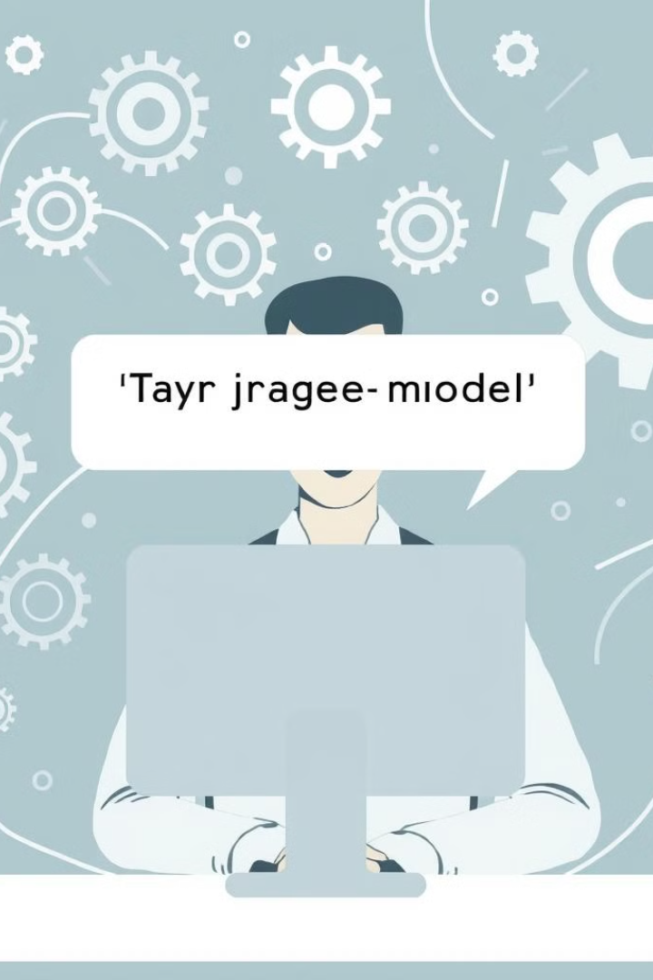

Understanding Prompt Engineering
1
Defining Prompt Engineering
2
The Importance of Prompt Design
Prompt engineering is the process of crafting prompts that effectively communicate the desired task or output to a language model, enabling it to generate relevant, coherent, and high-quality responses.
Well-designed prompts are crucial for language models to understand the context, intent, and requirements of the task at hand, leading to more accurate, relevant, and useful outputs.
3
The Iterative Nature of Prompt Engineering
Prompt engineering is an iterative process, where prompts are continuously refined and improved based on the model's responses, feedback, and evolving task requirements.

Slide 3
The Fundamentals of Prompt Design
Task Description
Context Clues
Formatting and Structure
Clearly define the task or objective you want the language model to accomplish, using specific and unambiguous language.
Provide relevant background information, domain knowledge, and contextual cues to help the model better understand the task and generate more appropriate responses.
Use formatting, such as bullet points, headings, and formatting tags, to organize the prompt and make it easier for the language model to parse and understand.

Slide 4


Real-World Applications of Prompt Engineering
Content Creation
Problem-Solving
Prompt engineering can be used to generate high-quality content, such as articles, stories, and product descriptions, by providing the language model with detailed instructions and context.
Language models can be prompted to tackle complex problems and generate innovative solutions by providing them with the necessary background information, constraints, and guiding questions.
1
2
3
Task Completion
Prompts can be used to direct language models to complete specific tasks, such as research summaries, code generation, or data analysis, by clearly defining the requirements and desired outputs.

Slide 5

Prompt Engineering: Opportunities and Challenges
Opportunities
Challenges
Prompt engineering unlocks the vast potential of language models, enabling users to harness their capabilities for a wide range of applications, from content creation to problem-solving to task automation.
Crafting effective prompts requires a deep understanding of language models, their capabilities and limitations, as well as the specific task requirements. Continuous experimentation and refinement are often necessary to achieve desired results.
Ethical Considerations
Prompt engineering raises important ethical questions, such as the potential for misuse, bias, and unintended consequences. Responsible development and deployment of language models requires careful consideration of these issues.

Slide 6





Prompt Engineering: Use Cases and Applications
Content Generation
Software Development
Prompt engineering can be used to generate high-quality and diverse content, such as articles, stories, product descriptions, and marketing copy.
Prompts can be used to generate code, debug issues, and provide solutions to programming challenges, streamlining the software development process.
Research and Analysis
Task Automation
Language models can be prompted to summarize research, synthesize findings, and provide insights, supporting various research and analysis tasks.
Prompt engineering can be leveraged to automate a wide range of tasks, from data entry to project management to customer service, improving efficiency and productivity.

Slide 7




Prompt Taxonomy: Types and Structures
Open-Ended Prompts
These prompts encourage the language model to generate creative, diverse, and open-ended responses, often used for tasks like brainstorming and ideation.
Closed-Ended Prompts
Closed-ended prompts are more specific and direct, guiding the language model to provide a targeted response, such as a recommendation or a solution to a problem.
Multi-Part Prompts
These prompts consist of multiple instructions or questions, often used to break down complex tasks or elicit a more comprehensive response from the language model.

Slide 8
Prompt Optimization Techniques
Prompt Iterration
Prompt Augmentation
Prompt Evaluation
Continually refining and testing prompts based on the language model's responses, feedback, and evolving task requirements is essential for optimizing prompt performance.
Expanding prompts with additional context, instructions, and formatting can help language models better understand the task and generate more relevant and coherent responses.
Analyzing the quality, relevance, and consistency of the language model's outputs can inform prompt refinement and optimization, ensuring the desired results are achieved.

Slide 9

Ethical Considerations in Prompt Engineering
1
Bias and Fairness
2
Transparency and Accountability
Prompt engineers must be mindful of the potential for language models to perpetuate or amplify societal biases, and work to develop prompts that promote fairness and inclusivity.
Prompt engineering should adhere to principles of transparency, with clear documentation of the prompt design process and the language model's capabilities and limitations.
3
Responsible Development
Prompt engineering requires a thoughtful approach that considers the potential for misuse and unintended consequences, and prioritizes the development of prompts that serve the greater good.

Slide 10

The Future of Prompt Engineering
Advancements in Language Models
1
As language models continue to evolve, with increasing capabilities, breadth of knowledge, and contextual understanding, prompt engineering will become an increasingly important and powerful tool for unlocking their potential.
2
Interdisciplinary Collaboration
The future of prompt engineering will likely involve greater collaboration between domain experts, language model researchers, and prompt engineers, fostering the development of more specialized and effective prompts across various industries and applications.
Automated Prompt Generation
3
As the field of prompt engineering matures, we may see the development of AI-powered tools and algorithms that can automatically generate and optimize prompts, further streamlining the process and making it accessible to a wider audience.

Slide 11



Conclusion
Collaborative Approach
Continuous Innovation
Inclusive Development
Prompt engineering is a collaborative effort, requiring domain experts, language model researchers, and prompt designers to work together.
As language models evolve, prompt engineering will continue to be a crucial and rapidly advancing field, unlocking new possibilities.
Prompt engineering must prioritize fairness, transparency, and responsible development to ensure language models serve the greater good.

